Slide 1
Biology
Unit 1: The Living Systems
Lesson 1: Life in the Earth System
Notes:
The learning experiences in this unit prepare students for the mastery of
Performance Expectations
LS1-2 Develop and use a model to illustrate the hierarchical organization of interacting systems that provide specific functions within multicellular organisms.
LS1-3 Plan and conduct an investigation to provide evidence that feedback mechanisms maintain homeostasis.
ETS1-2 Design a solution to a complex real-world problem by breaking it down into smaller, more manageable problems that can be solved through engineering.
ETS1-3 Evaluate a solution to a complex real-world problem based on prioritized criteria and trade-offs that account for a range of constraints, including cost, safety, reliability, and aesthetics, as well as possible social, cultural, and environmental impacts.

Slide 2

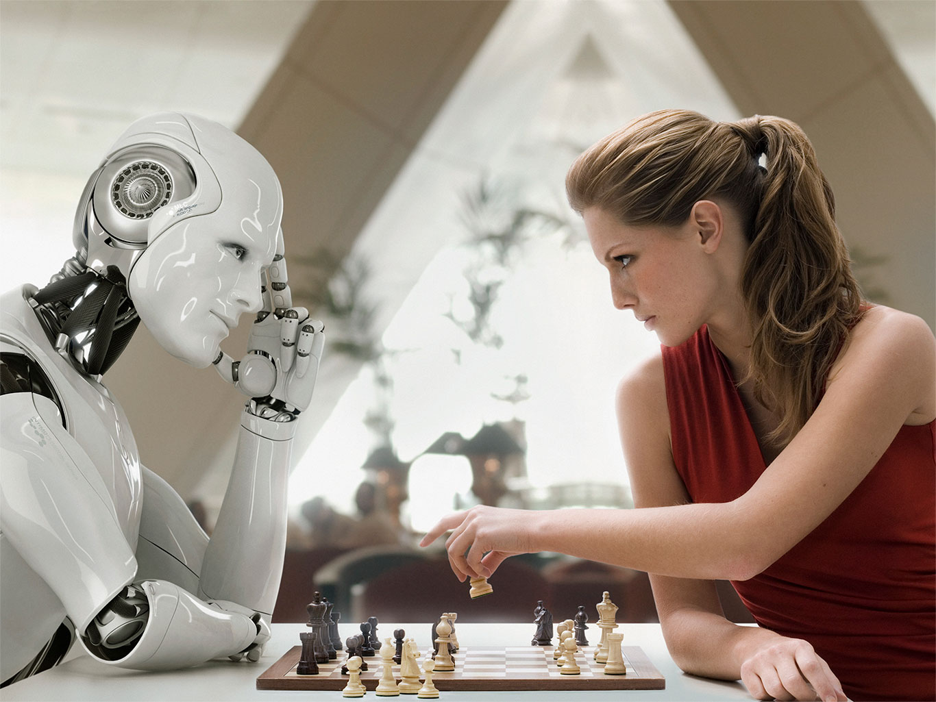
Can You Explain It?
Unit 1 Lesson 1
Imagine a company that sells robots like the one shown above. The company makes the claim: "This living machine is the perfect companion." Make a case to either support or refute this claim. How similar are living and nonliving systems?
Although the robot in this image is conceptual, robots can be programmed to carry out very complex tasks, such as playing a game of chess.
Notes:
Lesson Objective
To use models to illustrate the relationships between components of living and nonliving systems.

Slide 3
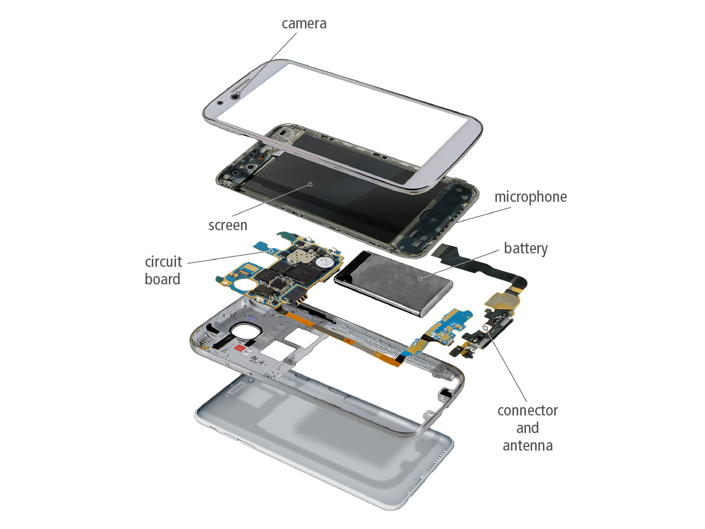
Systems and Systems Models
Unit 1 Lesson 1
A system is a set of interacting components considered to be a distinct entity for the purpose of study or understanding.
Collaborate: What systems could you define in the world around you?

Slide 4
Systems and Systems Models
Unit 1 Lesson 1
ANALYZE
What is the boundary of the human body?
What is the boundary of a robot?
Compare the inputs and outputs of humans and robots in terms of matter and energy.

Slide 5
Systems and Systems Models
Unit 1 Lesson 1
Boundaries and Components
Inputs and Outputs
Open and Closed Systems
Controls
Is the human body an open, closed or isolated system?
Is a robot an example of an open, closed, or isolated system?
Feedback is information from one step of a cycle that acts to change the behavior of a previous step of a cycle.

Slide 6
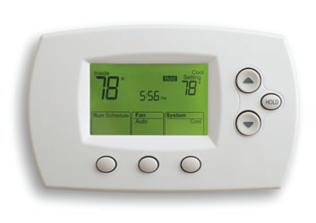
Systems and Systems Models
Systems and System Models
Unit 1 Lesson 1
A thermostat can be used to control the heating ad cooling systems in a home.
Some air conditioners and heaters have a control system called a thermostat.
A thermometer inside the thermostat continually measures the temperature in the room.

Slide 7
Unit 1 Lesson 1
Systems and Systems Models
GATHER EVIDENCE
How do your interactions with nonliving systems affect your environment?

Slide 8
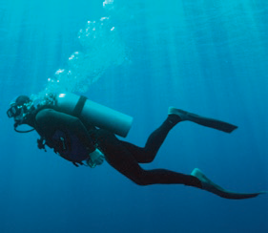
Unit 1 Lesson 1
Systems and Systems Models
The scuba diver is a living system. The scuba gear, or self-contained underwater breathing apparatus, is a system of air exchange.
How are these systems interacting?
What are the inputs and outputs?

Slide 9
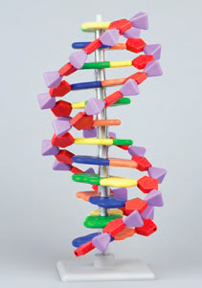
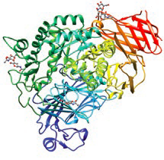
Unit 1 Lesson 1
Systems and Systems Models
A model is a pattern, plan, representation, or description designed to show the structure or workings of an object, system, or concept.

Slide 10
Unit 1 Lesson 1
Systems and Systems Models
MODEL
Develop a short list of systems that you think biologists would want to model.
Choose one system from your list, and develop a plan for how you would model it.

Slide 11
Unit 1 Lesson 1
Systems and Systems Models
We can apply systems thinking to biology.
Systems biology studies biological systems as an integrated whole.
An emergent property is a property that is a system but that has its components do not have; the sum is greater than the parts.

Slide 12
Unit 1 Lesson 1
Systems and Systems Models
EXPLAIN
Describe how different types of models could be used to research a disease. Make a list of questions you would ask. Categorize your questions into different fields of science that might be involved in the research.

Slide 13
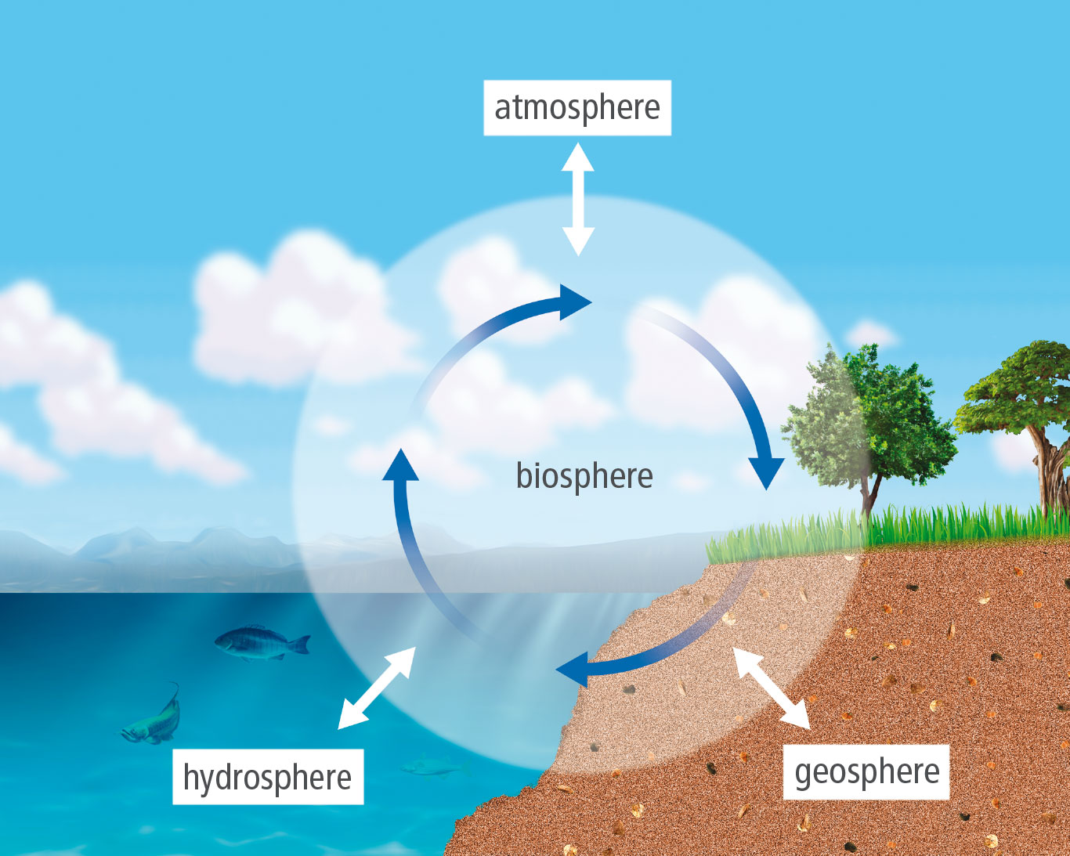
Unit 1 Lesson 1
The Earth System
The system model shown organizes the Earth system into four interconnected systems, or spheres:
geosphere
hydrosphere
biosphere
atmosphere

Slide 14
Unit 1 Lesson 1
The Earth System
EXPLAIN
The model shows the biosphere in the middle of the diagram with arrows connecting it to the other spheres.
Why is the biosphere depicted this way?

Slide 15
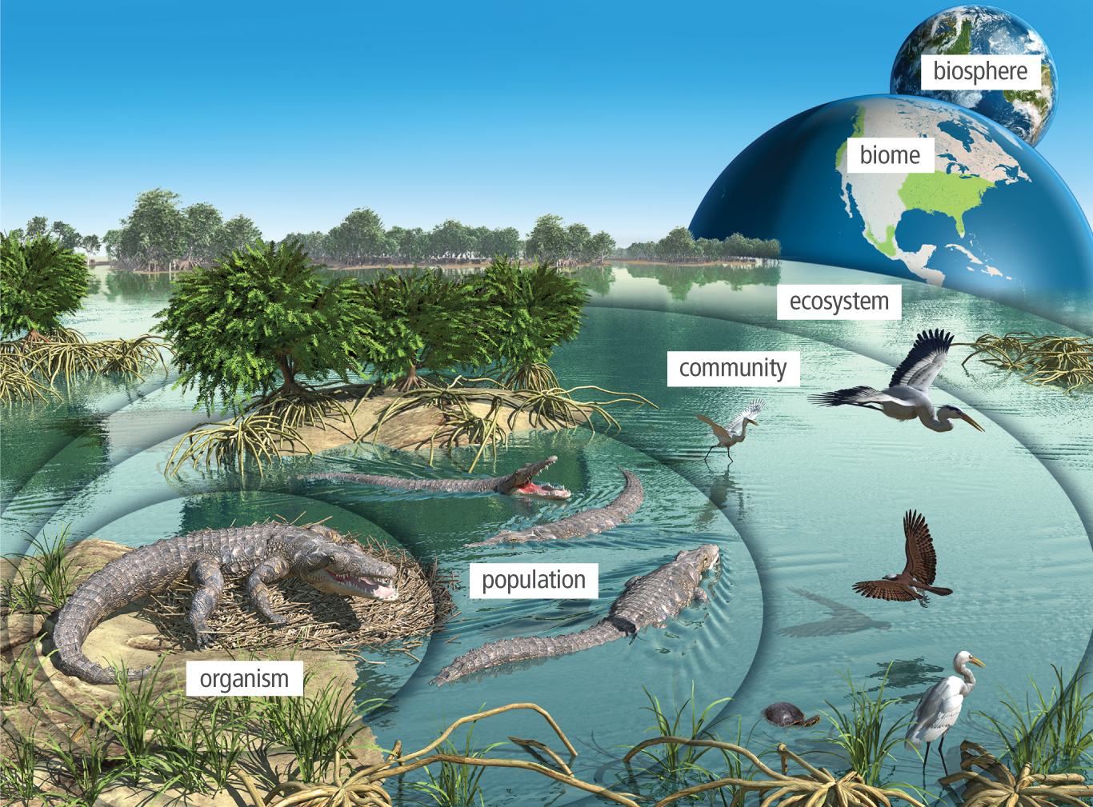
Unit 1 Lesson 1
The Earth System
An ecosystem includes nonliving and living things, or organisms, in a given area.
The living components in an ecosystem are called biotic factors. The nonliving components of ecosystems are abiotic factors.

Slide 16

The Earth System
Hands-On Lab: Life Under a Microscope
Unit 1 Lesson 1
Observe pond water under a microscope and determine whether items are living or nonliving based on their observable characteristics.

Slide 17
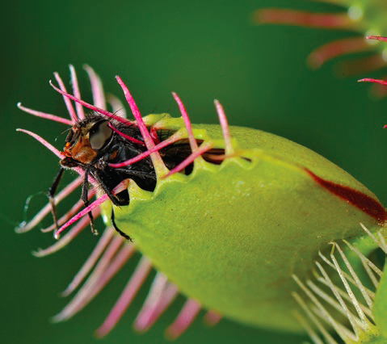
Unit 1 Lesson 1
The Earth System
Scientists use a set of characteristics to define living things.
Homeostasis is the maintenance of constant internal conditions in an organism.

Slide 18

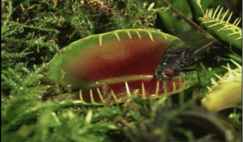
Unit 1 Lesson 1
The Earth System
A Venus flytrap plant obtains energy from the sun and
nutrients by consuming insects.

Slide 19
The Earth System
Hands-On Lab: The Study of Life
Unit 1 Lesson 1
Plan and conduct an investigation to determine how different factors affect the number of living things found in a soil sample.

Slide 20
Unit 1 Lesson 1
Continue Your Exploration
Choose one of the paths below to continue your exploration:
Modeling a System
Viruses: Are They Alive?
Life Under a Microscope

Slide 21
Can You Explain It?
Unit 1 Lesson 1
Refer to the notes in your Evidence Notebook to help you explain whether or not a robot fits the criteria of a living system. Consider the following questions when developing your explanation:
Which properties of systems does the robot have, and which does it not?
Which properties of living things does the robot have, and which does it not?
What potential emergent properties could this robot have?
For each of the above questions, include specific examples and evidence to support your claims.

Slide 22
Image Credits
Unit 1 Lesson 1
robot playing chess ©Blutgruppe/Corbis; thermostat ©iStock/Getty Images Plus/koinseb; scuba diver ©Photographer's Choice RF/Georgette Douwma/Getty Images; DNA computer model Image of PDB entry 3L4V created with Chimera (http://www.rbvi.ucsf.edu/chimera/); Venus flytrap with fly ©Francesco Tomasinelli/Science Source; DNA model ©alice-photo/Shutterstock; Venus flytrap video ©Photolibrary Video/Oxford Scientific Films/Getty Images

